Slide 1
Pluggable DPIF - Unlocking accelerated OVS full potential
RRoi Dayan, Roni Bar Yanai, Eli Britstein, Nov 2024
Notes:
Slide#2: HW Acceleration is a must
Slide#3: How does HW acceleration works (slow path, rules offloading, etc.)

Slide 2
HW Acceleration is a must
VM
None accelerated
Accelerated
AI App
Evolving Cloud Workloads: Cloud applications demand extremely high bandwidth and low latency to meet modern performance requirements.
Performance Challenges:
Maintaining scalability under high-performance demands.
Handling processing speeds at hundreds of gigabits per second.
Open vSwitch (OVS) must leverage hardware acceleration to:
Remain competitive in high-performance environments.
Reduce CPU load.
Low and constant latency
High CPS
QP
OVS
RoCE
p0
p1
HW
p0
p1

Slide 3
OVS acceleration Journey
DPIF-NETlink (OVS-Kernel)
DPIF-NETDEV (OVS-DPDK)
OVS-P4
CLI
Open Flow
Future extensions
OVS
OVS-DPDK
OVS-DOCA
OVS-Kernel
DPIF Netdev (DPDK)
DPIF Netlink (Kernel)
Netdev Offload DPDK
Netdev Offload tc
DPDK rte_flow
DOCA Flow
tc
…
…
…
Hardware
Legend:
Community
Community+NVIDIA
NVIDIA

Slide 4
DPIF-NETlink
OVS Kernel acceleration is non-optimal
TC (Linux traffic controller) is the acceleration API
OVS relies on the kernel for part of the data path, using TAP devices like VXLAN
Packets leaving OVS to the kernel and returned via a different device lose context
Kernel components like routing tables, FIB, and netfilter are scattered
Complex Synchronization (e.g. driver & routing table)
A holistic view of the packet pipeline is not achievable, packet cannot carry information between pipeline stages
SW is heavy (compared to less generic use case) and dictates slow CPS (CT)
BR-INT
VF
vxlan
vxlan
VF ip
kernel
BR-EXT
rep
p0
While achieving significantly better performance compared to software and improving further with new hardware, the results are still far from the max possible performance

Slide 5
DPIF-NETDEV
OVS-DPDK
OVS executes an end to end pipeline, packets are handled in run-to-completion (does not leave context and return out-of-the-blue). Offering better context (some used by EMC and SMC – OVS caches)
HW acceleration relies on DPDK-based rte_flow API
rte_flow is a low-level API, allows redundant methods to achieve the same pipeline
Vendors have unique limitations on supported matches and actions
This creates API conflicts, making the API too low-level for generic use case
The offload API at the netdev level lacks context. It provides the acceleration layer with only a narrow view of the pipeline
Customers often use OVS-DPDK and develop their own acceleration layer on top of DPDK rte_flow

Slide 6
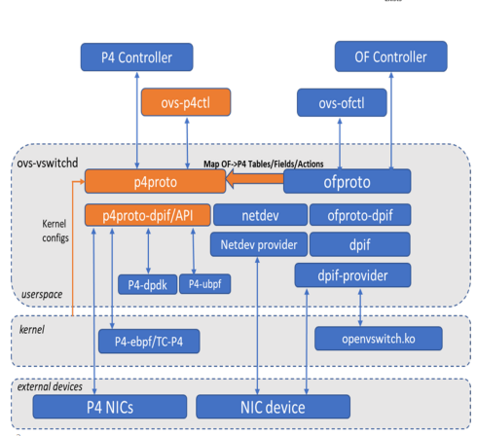
OVS-P4
A third acceleration API
There were few attempts to introduce P4 to OVS
OVS Datapath Specialization using P4 - OVS Conference 2015
IPDK - OVS with P4 Walkthrough 2022
OVS 2022 Conference - Using OVS with P4 Coprocessor
OfP4, a P4 front end for Open vSwitch
Eventually P4 is not part of OVS
Probably because P4 its too different than other acceleration API
The following architecture which has p4-dpif was suggested

Slide 7
HW acceleration challenges with current OVS Arch

Slide 8
Partial execution of pipeline actions
CT as an example
OVS uses Connection Tracking (CT) as an action
CT action can be placed after some packet modification already happened
CT miss requires SW involvement, but SW is now broken
The software receives a partially processed packet and may not know how to handle it. It must resume actions from where they stopped, which is challenging, leading to malfunctions and inconsistencies
ct_state(-trk),recirc_id(0),in_port(6),packet_type(ns=0,
id=0),eth(src=fa:16:3e:1f:66:29,dst=fa:16:3e:53:10:28),eth_type(0x0800),ipv4(src=172.16.0.101/128.0.0.0,proto=1,frag=no), packets:8, bytes:784,used:0.909s,actions:set(eth(src=fa:16:3e:fd:98:0c,dst=fa:16:3e:53:10:28)),push_vlan(vid=2,pcp=0),ct(zone=2,label=1209),recirc(0x5eb2)
What if this is a new connection that is not in HW. Packet was already modified, OVS SW might miss

Slide 9
dP_HASH
HW hash might be different than SW or other vendors
DP_HASH runs “Jenkins hash” function on 5-tuple and than jumps to one of X buckets, who have actions
HW might have a different hash function than Jenkins or other SW implementation hash, leading to consistency issues between HW accelerated pipes and SW pipes, and causing network failures and e.g. tcp disconnections
Having SW & HW using the same hash could solve this problem (SW to use HW capability)
SW hash
Hash X
Action A
First packet might have a different path
Netdev 0x14 NVIDIA suggested a path, but it didn’t get through
Having SW and HW sync on hash is a must!
Action B
Action C
HW hash
Hash y

Slide 10
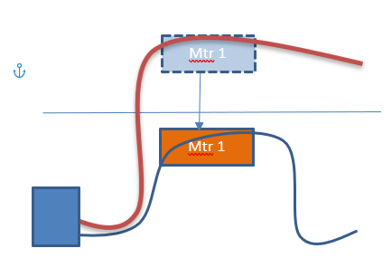
Meter
Using always HW State
Some packets reach the software, which might share the same meter
If the meter state is in hardware, packets in SW must be synched with it
Different HW might have different approaches to solve this problem
Current solution is sending packet back to HW for metering
NVIDIA plans to allow software to update the mete
(not supported with current hardware)
SW
HW

Slide 11
OVS conntrack
Why go to SW path?
HW may have its own connection tracking (CT) implementation
SW shadow is often unnecessary and consumes many cycles
HW might prefer alternative hardware-based approaches (making SW logic meaningless)
SYN/FIN/RST go to SW with flow index
HW CT
Other packets continue in HW

Slide 12
Aging
HW is very different
Mega-Flow
OVS tracks idle time for each mega flow
If the rule is in hardware, software counters won't advance
HW counters support are different across hardware types (e.g. Rx, Tx, before and after)
Ideally - HW rules would be aged out automatically (autonomously) while OVS just sets the time
This requires OVS to be deeply hardware-acceleration aware
NVIDIA offers efficient hardware aging.
OVS only needs to call the API for aged-out flows, with no need for additional software involvement

Slide 13
No Context
SMC/EMC caches
OVS data path has its own optimizations, like squeezing into EMC or SMC cache, this is dpif specific data path optimization
HW acceleration is currently below and has no context info (flow went through 3 CT tables, HW can handle one flow for the complete E2E)

Slide 14
Summary
HW acceleration has many challenges
Missing HW based solutions like CT
Split state between HW and SW
Miss path (state of the flow in the middle)
Performance – what HW can do in best against current implementation
Other issues: threading model, support for security pipelines, memory management, etc.
Conclusion: DPIF NetDev requires major re-architecture changes to support the existing basic functionalities with different HW

Slide 15
HW Acceleration is a data path
Going to the next level of performance

Slide 16
Customers selected architecture
Generates their own DPIF!
Customers that have their own flavor of OVS are usually:
Forking DPIF-NETDEV
Having their own completely unique OVS offload API HW offload that is strongly integrated with slow path
Staying close to user space updates but have their own unique HW acceleration strategy
Their offload API are based on:
DPDK rte_flow (legacy usage)
DOCA FLOW (recent engagements)

Slide 17
Integrated HW acceleration in Data path (DPIF)
SW path must be HW accelerated aware
Problem with accelerating existing data path (dpif-netdev, or dpif-netlink), disregarding the problems stated earlier
Different strategies must be applied when using HW acceleration, e.g. mega-flow aging might overwhelm the SW control pipe
Packet that had a miss in middle of HW flow and waited in queue might reach a point where it is not valid (hit different set of “old” rules in HW and now there are “new” rules in SW) → SW must be HW accelerated aware
Moving from HW to SW and back to HW can cause significant cost in packet’s out-of-order
Synchronization of HW flows and SW flows might look very different among non-common HW capabilities, for example, sync vs async API, latency, keys sizes, carrying information HW to SW…etc.

Slide 18
Integrated HW acceleration in Data path (DPIF)
HW Optimizations
SW has some SW data path optimizations such as EMC/SMC, rebalance queues…etc.
HW cannot benefit from that. HW can benefit by applying a different set of optimizations which suitable for HW, and for a specific API
Using HW specific strategies
Since slow path handles much less packets, more time can be spent on optimizations
Sharing resources
Squeezing data plane rules (knowing HW is fast enough to do quick update)
Having packets completing pipeline in HW
First packet that generate mega-flow, is sent back to HW to execute

Slide 19
Integrated HW acceleration in Data path (DPIF)
Slow Path and HW acceleration should be mixed
In some cases, packet should be sent to complete the pipeline in HW.
For example, when all a mega-flows are in place and only CT entry is missing for a new flow, it is much better to just send the packet back to HW with next recirc-id, and meta-data to continue the pipeline.
This is true also for the start point, if packet is missed on CT it should just go directly to CT code.
It might be that CT code is running on dedicate HW code.
Separating CT by itself is not good enough, but if separated is means this is vendor CT at least. The CT and mega flows share meta data that also must be defined, and CT sends packet back to HW.
In addition, this is just one possible model when using HW acceleration, different vendors might have different requirements.
HW
OVS
NIC
Logic
Mega flows
CT

Slide 20
Conclusions
DPIF must be pluggable and HW specific for best datapath impact
Offloading the existing data path cannot achieve optimal hardware performance. Like OVS-DPDK benefits from software optimizations, hardware acceleration requires unique, hardware-focused strategies
Hardware acceleration must be tightly integrated into the software data path. This integration depends on the hardware (e.g., P4 vs. DOCA Flow) and can differ significantly (Best solution must have an HW specific arch)
Having such integrated API that can hold different technologies will have a huge impact on dpif-netdev and community effort and might affect SW only performance
DPIF was already designed for holding different data paths (common API) and HW acceleration is just one of them
Loadable DPIF reduces community effort by being handled by their vendors, while keeping full compatability with OVS functionalities on the upper layer
Enables a formal and healthy adoption of what Is already happening anyway by customers
OVS can be continuously adopted and used in modern cloud tight requirements, with increased innovation

